Slide 1

Selenium Project “A method of automatically testing Amazon” Group 10
RunYang Zhou
Kaiyuan Zhao
Lai Zhang

Slide 2
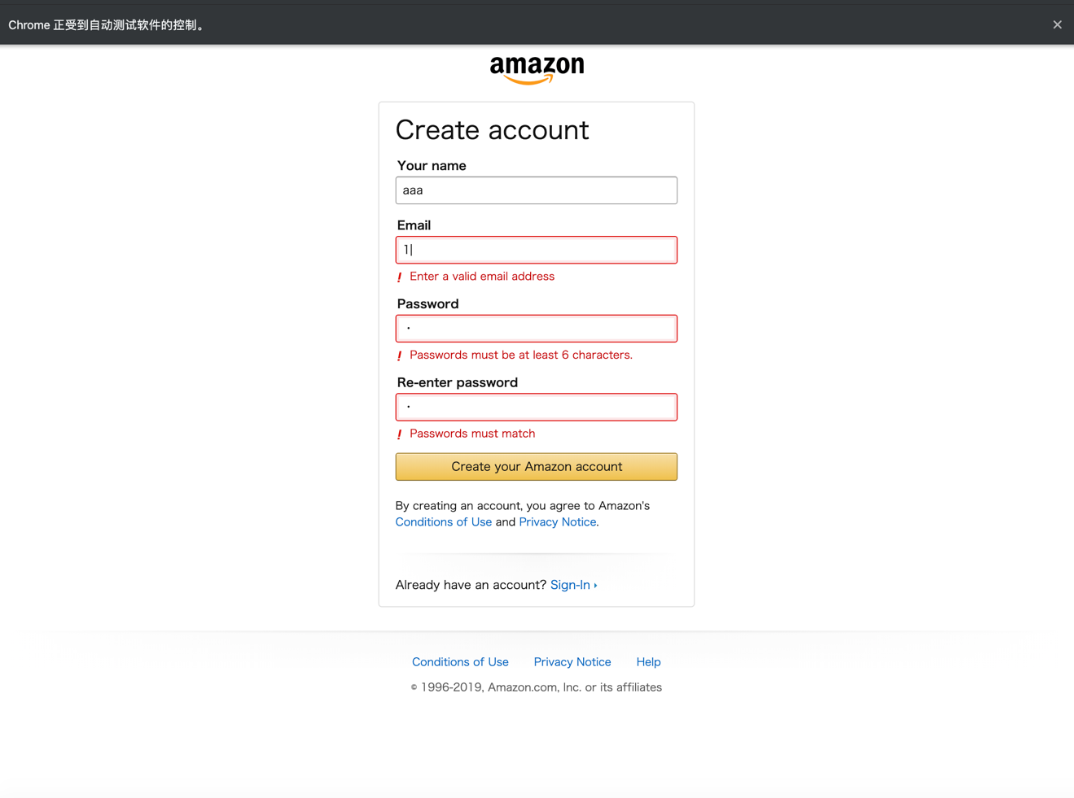
Step 1: Negative case where user put invalid email address and password mismatch

Slide 3
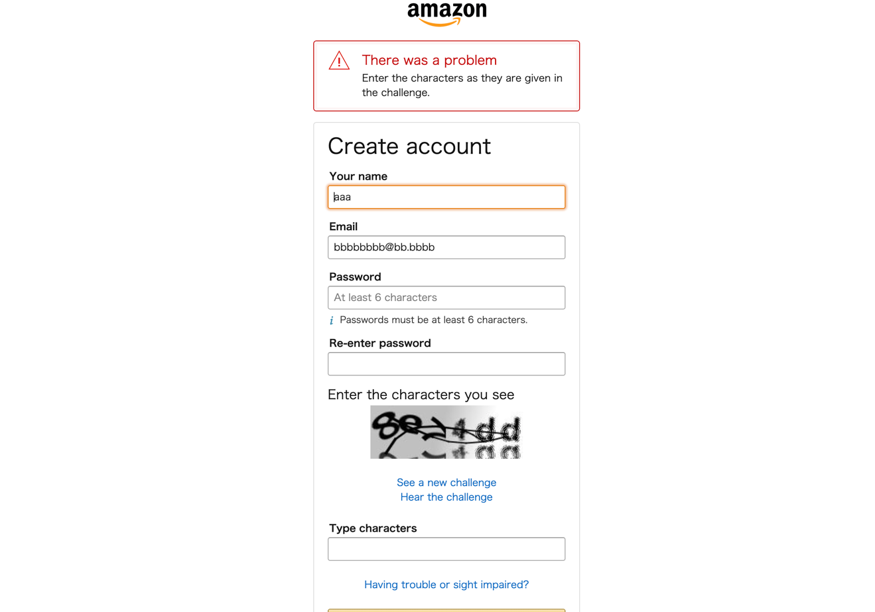
Step 2: Positive case where user put invalid email address and password match

Slide 4
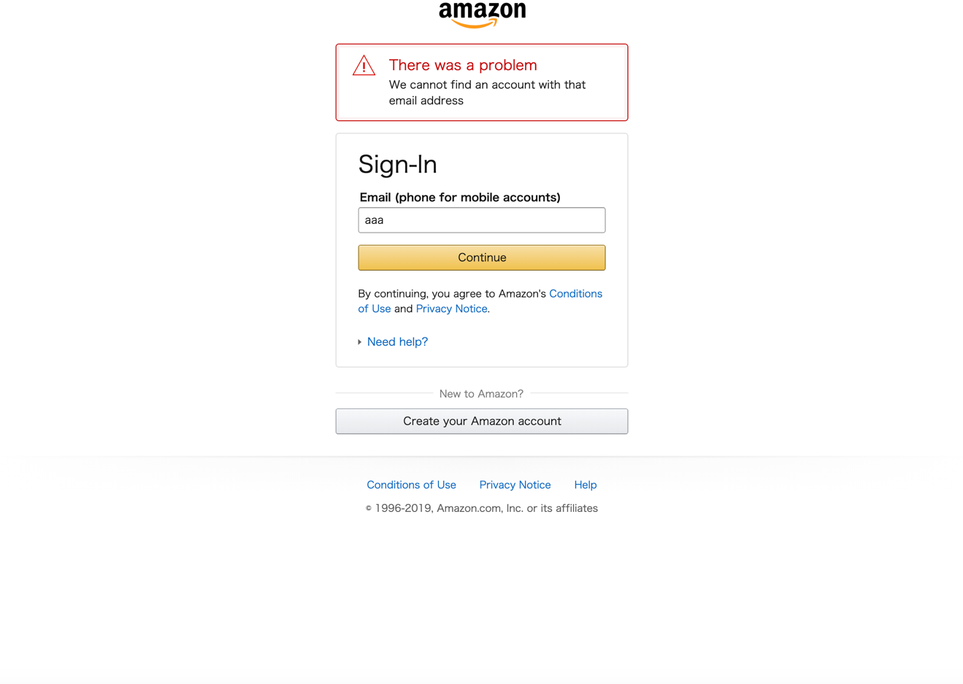
Step 3: Negative login

Slide 5
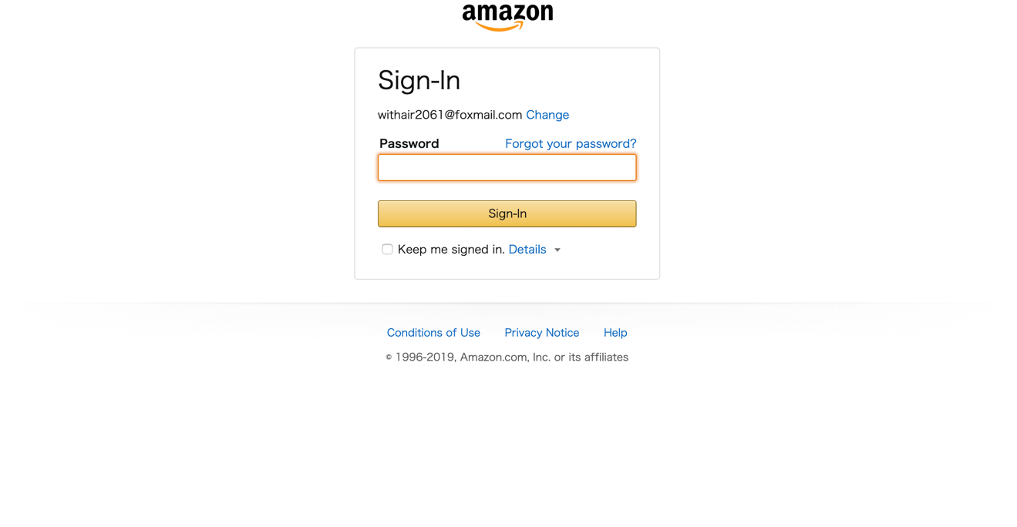
Step 4 Positive login

Slide 6
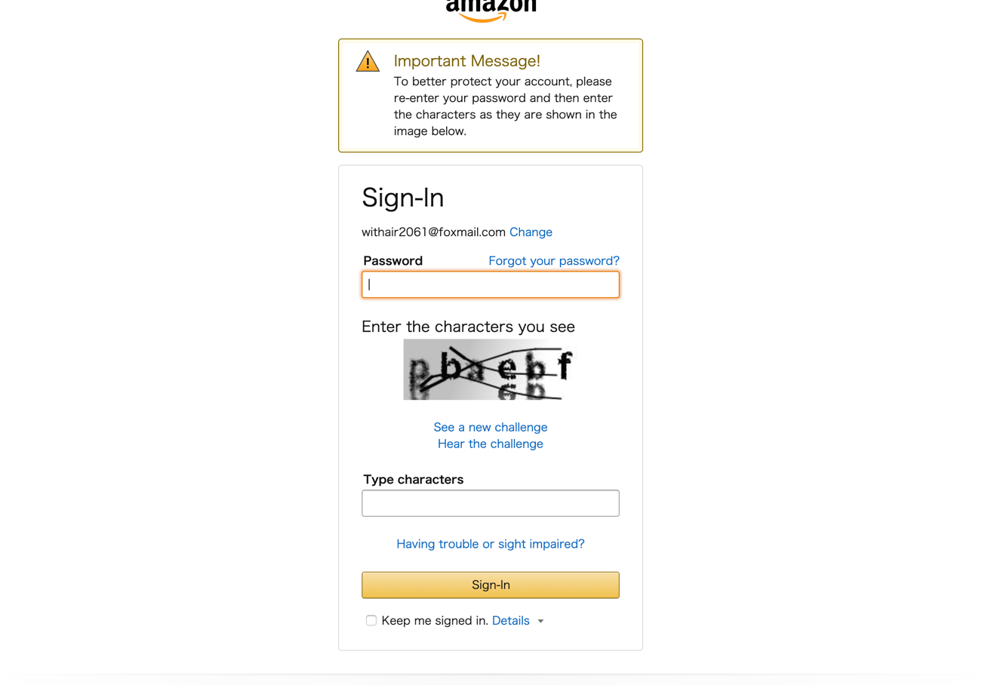
Step 5: Positive login with authentication page pops out

Slide 7
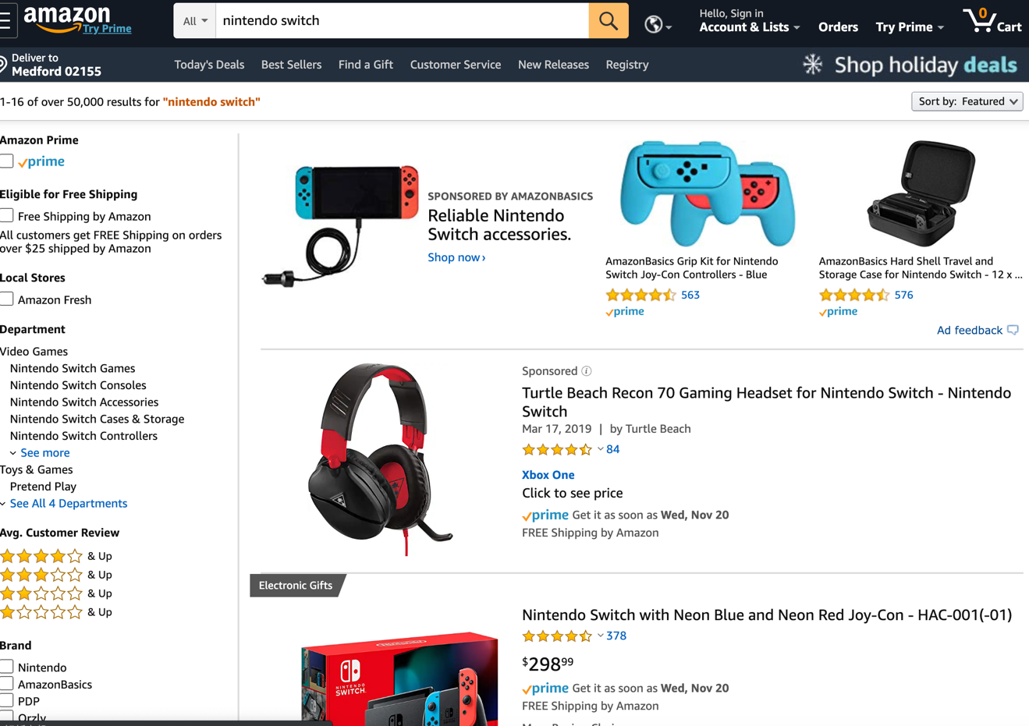
Step 6: Search item with search results

Slide 8
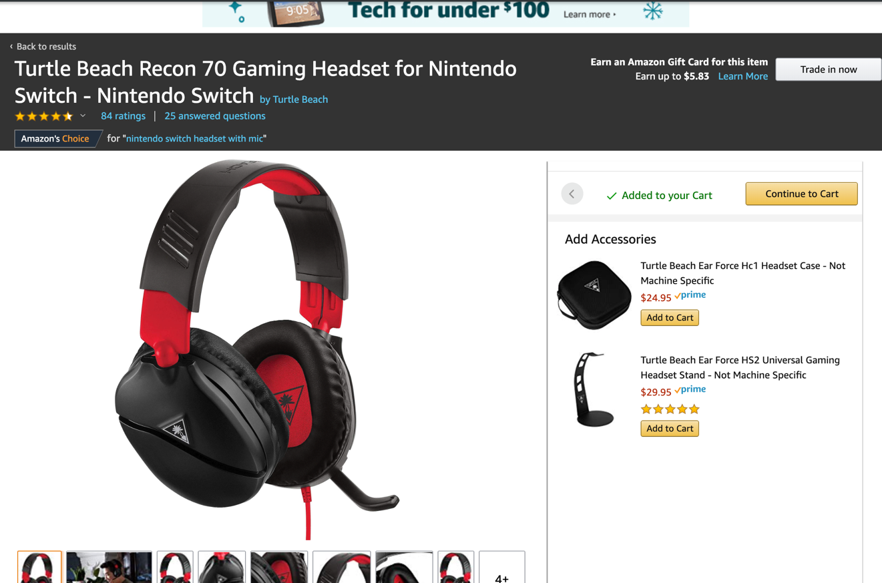
Step 7: Select the first search result and add to the cart

Slide 9
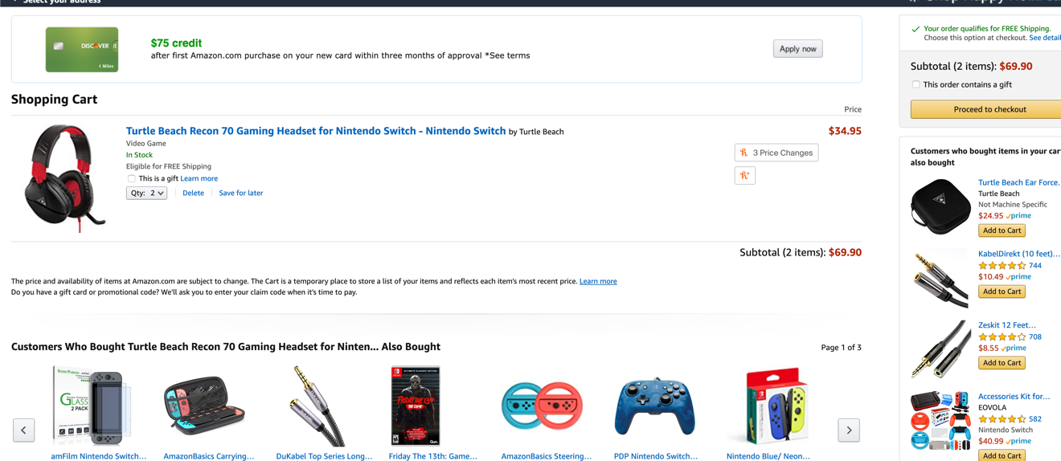
Step 8: Clicking checkout

Slide 10
Participation
RunYang Zhou : 40%
Sign up and log in with positive case and negative case.
Validation for the authentication.
HTML report.
Kaiyuan Zhao: 30%
Valid different scenarios of adding to cart.
Products check out function.
Writing report with screen shots.
Lai Zhang: 30%
Functions for adding searched result into cart.
Search function for products in www.Amazon.com

